Slide 1
Annotation of cell subpopulations using SingleR
Practices

Slide 2
1. Introduction to Cell Annotation
Cell type annotation is an important task for single-cell study, and in the aforementioned process, we have obtained marker genes for each subpopulation and can annotate cell types according to the biological functions or pathways in which these marker genes are involved. It is roughly divided into manual annotation and software annotation.
Manual annotation: with the help of a literatures or in combination with commonly used databases
cellMarker (http://biocc.hrbmu.edu.cn/CellMarker/)
PanglaoDB (https://panglaodb.se/)
CancerSEA (http://biocc.hrbmu.edu.cn/CancerSEA/)
Software annotation: usually implemented with the help of some existing tools, such as SingleR, etc. The advantage is that it can be automated, but the accuracy may not always be good and often requires manually checking the results.
SingleR is a stand-alone single cell annotation tool, independent of scRNA analysis pipelines (can be integrated with Seurat, SCE, etc.).
The reference dataset obtained from the celldex package has two cell type annotations, defined as label.main and label.fine.
Notes:
http://bioconductor.org/books/release/SingleRBook/introduction.html#motivation

Slide 3
2. Introduction to SingleR
The Bioconductor package ‘SingleR’ implements an automated annotation method for single-cell RNA sequencing (scRNA-seq) data (Aran et al., 2019). Given a reference dataset of known labels (individual cells or bulk RNA), it can assign these labels to new cells from the test dataset based on expression profile similarity.
The most common application of SingleR is to predict cell types (or "states" or "species") in a new dataset. In this case, manually interpreting cell clusters and defining marker genes only needs to be done once for the reference dataset, and can be transferred to the new dataset automatically.
Notes:
http://bioconductor.org/books/release/SingleRBook/introduction.html#motivation

Slide 4
SingleR is a variant of nearest neighbor classification, which makes some adjustments to improve the resolution of closely related labels. The basic principle is as follows:
Cell type prediction: For each cell in the scRNA-seq dataset, the SingleR algorithm uses a correlation-based approach to calculate the similarity score between the expression profile of the cell and the reference gene expression profile of the genome. The cell is then assigned to the cell type or cell state with the highest similarity score.
Estimation of statistical significance: The calculated similarity scores are compared to scores obtained from a random arrangement of cell labels to estimate the statistical significance of cell type predictions. This was done to determine if the observed similarity scores were significantly different from what would be expected by chance.
Single cell identification: Finally, the calculated similarity scores and their statistical significance are used to identify the cell type or cell state of each cell in the scRNA-seq dataset.
Reference cell types: are predefined databases that hold specific cell types or cell states. These gene sets are obtained from external sources or created based on prior knowledge. The annotated information provided by the celldex package is used here.

Slide 5
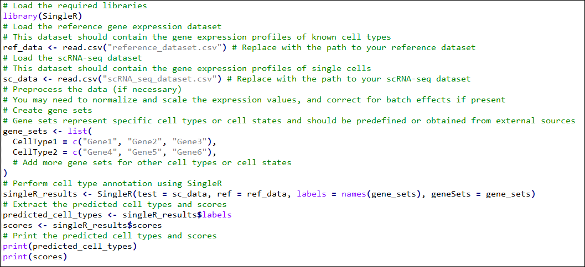
Example Code
Notes:
In this example, ref_data represents the reference gene expression dataset, which contains expression profiles for known cell types. sc_data represents the single-cell RNA sequencing dataset, which contains expression profiles for individual cells. Gene sets are created using the gene_sets list, where each gene set is represented by a named vector of gene names. The SingleR function is then used to perform cell type annotation and extract the predicted cell types and scores from the results. Note that the SingleR function also provides options to control various parameters (e.g. correlation methods, normalization methods, and permutation tests for statistical significance estimation). You can refer to the official documentation of the SingleR package for more information about these options and their usage.

Slide 6
3. Introduction to celldex
The celldex package provides convenient access to several cell type reference datasets. Most of these references are derived from bulk RNA-seq or microarray data of cell populations that (hopefully) consist of a pure cell type after sorting and/or culturing. The aim is to provide a common resource for further analysis like cell type annotation of single cell expression data or deconvolution of cell type proportions in bulk expression datasets.
Each reference data set has three columns:
label.main: provides the main cell types and contains only a small number of rare cell types that can be annotated quickly but at a lower resolution.
label.fine: provides more detailed cell categories by subtype or state, contains more unique cell types, slower annotation, but higher resolution.
label.ont: meticulous annotation compared to the standard vocabulary of cell ontology allows for consistent cell type labeling across different reference sets and dynamic adjustment of resolution.
View more information: ?ImmGenData

Slide 7
4. Common Reference Set in Celldex
Human Primary Cell Atlas (HPCA)
The HPCA reference consists of a publicly available microarray dataset derived from human primary cells (Mabbott et al., 2013). Most labels refer to blood subpopulations, but cell types from other tissues can also be used.
HumanPrimaryCellAtlasData()->ref
The reference set also contains many cells and cell lines that have been processed or collected from pathogenic conditions.
Blueprint/ENCODE
Consists of a large amount of RNA-seq data of pure stromal and immune cells generated by Blueprint (Martens and Stunnenberg 2013) and ENCODE Project (ENCODE Project Consortium 2012).
BlueprintEncodeData()->ref
This reference is best suited for mixed samples that do not require high resolution and is particularly suitable for situations where easy-to-interpret labels are quickly needed. It provides good immune cell granularity, although it does not contain the finer monocyte and dendritic cell subtypes.
Mouse RNA sequences
Contains a large collection of mouse RNA-seq datasets downloaded from the Gene Expression Omnibus (Benayoun et al., 2019). Multiple cell types can be used, again primarily from blood, but also including several other tissues.
MouseRNAseqData()->ref
Best suited for low-resolution labeling on a large number of tissue samples of brain, blood or heart is sufficient.
Notes:
http://bioconductor.org/packages/release/data/experiment/vignettes/celldex/inst/doc/userguide.html

Slide 8
Common Reference Set in Celldex
Immunogenome Project
The ImmGen reference contains a microarray profile of pure mouse immune cells from the project of the same name (Heng et al., 2008). This is the highest resolution immune reference available.
ImmGenData()->ref
The reference exhaustively covers a surprising number of cell subtypes. However, this can be a double-edged sword as the high resolution may be difficult to interpret, especially for samples from experimental conditions that are not of interest. Users may wish to remove certain examples themselves depending on the use case.
Immune Cell Expression/eQTLs/Epigenomics (DICE)
The DICE reference consists of a large number of RNA-seq samples from sorted cell populations from the project of the same name (Schmiedel et al., 2018).
DatabaseImmuneCellExpressionData()->ref
This reference is particularly useful for those interested in CD4+ T-cell subsets, although the lack of CD4+ central and effector memory samples may reduce accuracy in some cases. In addition, the lack of dendritic cells and individual B-cell subsets may result in these cell populations being mislabeled or their labeling being pruned in typical PBMC samples.
Novershtern Hematopoietic Data
Consists of a microarray dataset of classified hematopoietic cell populations from GSE24759 (Novershtern et al., 2011).
NovershternHematopoieticData()->ref
This reference provides the highest resolution for bone marrow cells and progenitor cells in the human immune reference. It has fewer T-cell subsets than other immune references but contains more NK, erythroid and granulocyte subsets. It may be the best choice for bone marrow samples.
Monaco immunization data
Bulk RNA-seq samples from the sorted immune cell population of GSE107011 (Monaco et al. 2019).
MonacoImmuneData()->ref
The human immune reference that best covers all bases of a typical PBMC sample. It provides a broad range of B and T cell subsets, distinguishes between classical and non-classical monocytes, includes basic dendritic cell subsets, and also includes neutrophil and basophil samples to help identify small contaminating populations that may have entered PBMC preparations.
Notes:
http://bioconductor.org/packages/release/data/experiment/vignettes/celldex/inst/doc/userguide.html

Slide 9
Tips
SingleR is more of a cell enrichment tool (similar to doing GO and KEGG enrichment)
According to the aforementioned introduction, users can define their own specific reference sets or, of course, provide custom marker genes to singleR, which facilitates the setup of personalized cell annotation analysis for specific biological questions.

